Slide 1
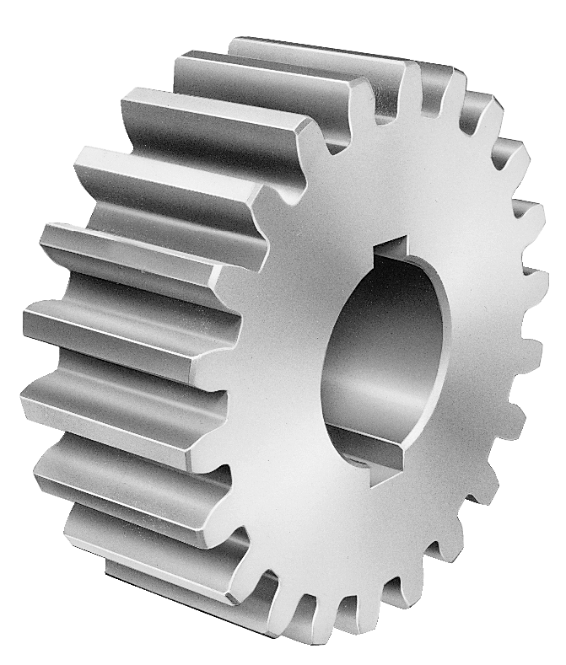
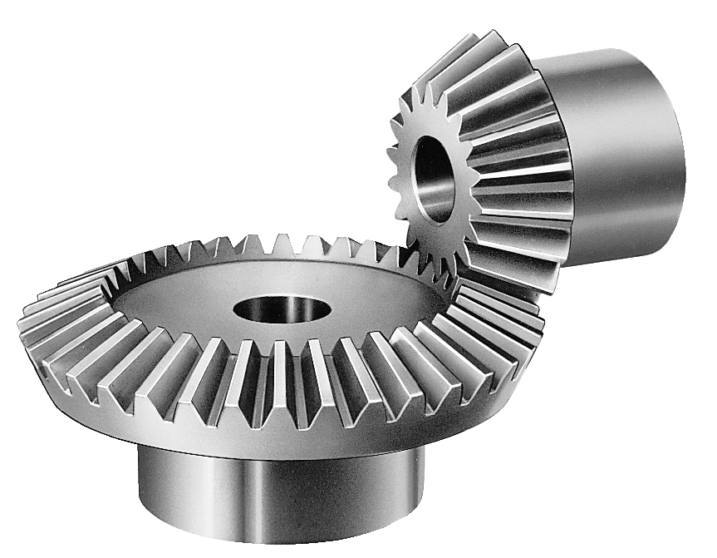
Simple Machines
Grade 4 Grzelak & Outrich

Slide 2
Conveyor Belts, Gears Circuits Power Robots
Time to go, now off to work
Notes:
Have students sing conveyor belts gears on pitches before they play on xylophone

Slide 3
Conveyor Belts, Gears

Slide 4
Conveyor Belts, Gears
D B C A D

Slide 5
Circuits Power Robots

Slide 6
Circuits Power Robots
D D B C A D

Slide 7
Conveyor Belts, Gears Circuits Power Robots
D B C A D
D D B C A D

Slide 8
Time to go, now off to work.

Slide 9
Time to go, now off to work.
D E F F E D

Slide 10
Time to go, now off to work.
D E F F E D

Slide 11
Time to go, now off to work.
D E F G F E D
Low or High????

Slide 12
Time to go, now off to work.
D E F G F E D

Slide 13
A section
Conveyor Belts, Gears Circuits Power Robots
Time to go, now off to work
D B C A D
D D B C A D
D E F G F E D

Slide 14
Bass Xylophone Ostinato
Gears are turning

Slide 15
Bass Xylophone Ostinato
(during A section)
Gears are turning
D D G A

Slide 16
F E D C

Slide 17
F D E D C

Slide 18
F D E C D C

Slide 19
F D E C D C

Slide 20
F D E C D B C

Slide 21
Spokes and Gears from lessons learned
F D E C D B C

Slide 22
Spokes and Gears from lessons learned
F D E C D B C
F D E C D B C
F D E C D B C

Slide 23
B C D E

Slide 24
B C D E D C B

Slide 25
B C D E D C B

Slide 26
Build the products that are yearned
B C D E D C B

Slide 27
B section
Spokes and Gears from lessons learned
F D E C D B C
F D E C D B C
F D E C D B C
B C D E D C B
Build the products that are yearned

Slide 28
Bass Xylophone Ostinato (during B section)
In- clined plane

Slide 29
Conveyor Belts, Gears Circuits Power Robots
Time to go, now off to work
D B C A D
D D B C A D
D E F G F E D

Slide 30
VIRTUAL XYLOPHONE
C
D
E
F
G
A
B
C
D
E
F
G
A
DIATONIC
Click the CENTER of the bars to play.
Click the BOTTOM of the bars to remove.
(Once removed they will still make sound)

