Slide 1
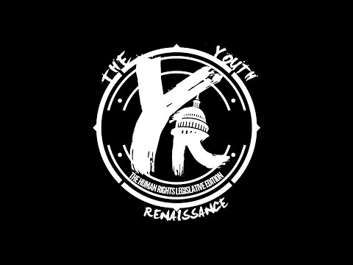
This documentary was created by my students and Reading RAMM as the culminating product for their year long project on Human Rights. It documents the process they went through to learn about our government at all 3 levels. We had a premier of the documentary at CCC- Metro and had a star studded event to promote their project. The whole Human Rights project was selected as a finalist in the New Tech Network’s Best in Network project.

Slide 2
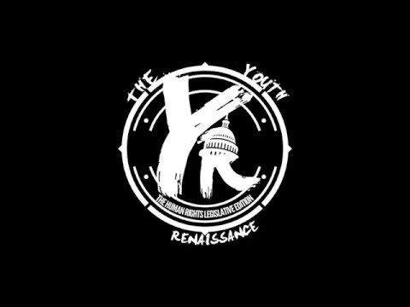
This is the trailer that the students made for their documentary. This was made in our school, with the assistance and guidance of Edward “DJ Phatty” Banks and Reading RAMM.

