Slide 1
Mental & Emotional Health
Teacher Resources

Slide 2
HECAT
Health Education Curriculum Analysis Tool Mental and Emotional Health: https://www.cdc.gov/healthyyouth/hecat/pdf/HECAT_Module_MEH.pdf

Slide 3
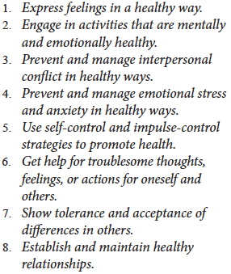
Lesson 1 –The Importance of MEH
8 MEH Health Behavior Outcomes for 9-12: https://www.cdc.gov/healthyyouth/hecat/pdf/HECAT_Module_MEH.pdf

Slide 4
Lesson 1 –The Importance of MEH
The Six Dimensions of Wellness: https://www.nationalwellness.org/page/Six_Dimensions

Slide 5
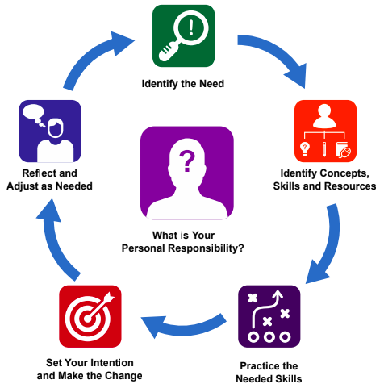
Lesson 1 – The Importance of MEH
Self-Management Model: https://drive.google.com/file/d/0B6RzG9AuQF-DLVZLX2NDUzA4N1U/view

Slide 6
Lesson 2 – Improving MEH
SMART Goals – Specific, Measurable, Achievable, Realistic, and Timely
All decisions have short- and long-term effects.
Short-term effects are consequences of a decision between now and the near future
Long-term effects are consequences of a decision “down the road.”

Slide 7
Lesson 2 – Improving MEH
Decision Making Model: https://drive.google.com/file/d/0B6RzG9AuQF-DVWJFVUlyeDJrTWM/view

Slide 8
Lesson 2 – Improving MEH
Goal Setting Model: https://drive.google.com/file/d/0B6RzG9AuQF-DUjZsOXJoQ0IzbUE/view

Slide 9
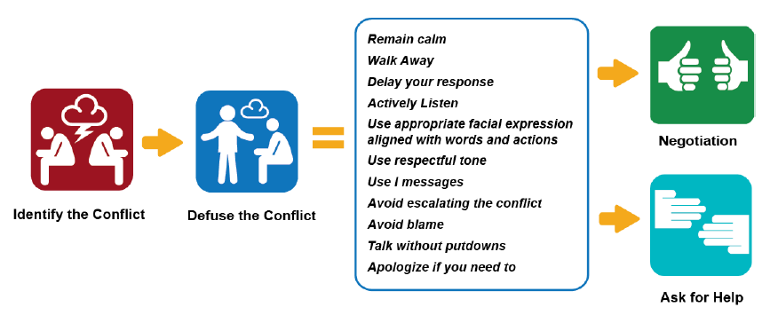
Lesson 3 – Interpersonal Conflicts
Defusing Conflict Model: https://drive.google.com/file/d/1_yaI4NF-XiZiGLLg0JX8R5qmsL9mQ6ZN/view

Slide 10
Lesson 3 – Interpersonal Conflicts
Negotiation Skills Model: https://drive.google.com/file/d/1_yaI4NF-XiZiGLLg0JX8R5qmsL9mQ6ZN/view

Slide 11
Lesson 3 – Conflict Resolution
HelpGuide.org (2017) Conflict Resolution Skills: https://www.helpguide.org/articles/relationships-communication/conflict-resolution-skills.htm?pdf=true

Slide 12
Lesson 4 – Coping with Grief and Stress
HelpGuide.org (2017) Coping With Grief and Loss: https://www.helpguide.org/articles/grief/coping-with-grief-and-loss.htm

Slide 13
Lesson 5 – Asking for and Offering Assistance
What is Self-Injury?: http://www.selfinjury.bctr.cornell.edu/perch/resources/what-is-self-injury-9.pdf
Mayo Clinic (2017) Self-Injury/Cutting: http://www.mayoclinic.org/diseases-conditions/self-injury/symptoms-causes/dxc-20165427

Slide 14
Lesson 5 – Asking for and Offering Assistance
What is Mental Health?: https://www.mentalhealth.gov/basics/what-is-mental-health
What To Look For: https://www.mentalhealth.gov/what-to-look-for

Slide 15
Curricula and Models
Mental Health and High School: http://teenmentalhealth.org/schoolmhl/wp-content/uploads/2015/09/Mental-Health-High-School-Curriculum-Guide.pdf

Slide 16
Teen Health
TeensHealth: https://kidshealth.org/en/teens/your-mind/?WT.ac=t-nav-your-mind
Educators: https://classroom.kidshealth.org
Parents: https://kidshealth.org/en/parents/?WT.ac=t2p_tab

Slide 17
Child Abuse and Neglect
Child Welfare Information Gateway: https://www.childwelfare.gov/pubPDFs/whatiscan.pdf

Slide 18
Preventing Self-Harm
Helpguide.org (2018): https://www.helpguide.org/articles/anxiety/cutting-and-self-harm.htm

Slide 19
Getting Help
For Young People Looking For Help: https://www.mentalhealth.gov/talk/young-people
Ohio Mental Health and Addiction Services: http://mha.ohio.gov
How to Get Help: https://www.mentalhealth.gov/get-help
Life Act for Teachers/Admins: http://lifeact.org/education/program-information/teachers-admins/

Slide 20
Getting Help
National Alliance for Mental Illness (Greater Cleveland): https://namigreatercleveland.org
SAMHSA Referrals: https://www.integration.samhsa.gov/clinical-practice/sbirt/referral-to-treatment

Slide 21
Teens and Parenting
APA Teen Resources: http://www.apa.org/research/action/teens.aspx
APA Parenting Resources: http://www.apa.org/research/action/parenting.aspx

Slide 22
School Climate
National School Climate Center: https://www.schoolclimate.org

Slide 23
School Connectedness
School Connectedness Overview: https://www.cdc.gov/healthyyouth/protective/pdf/connectedness_overview.pdf
Fostering School Connectedness for Teachers/Staff: https://files.eric.ed.gov/fulltext/ED511995.pdf

Slide 24
School Connectedness
School Connectedness Strategies: https://www.search-institute.org/wp-content/uploads/2017/11/cdc_school_connectedness_report.pdf
School Connectedness for Districts and Administrators: https://www.cdc.gov/healthyyouth/protective/pdf/connectedness_administrators.pdf

Slide 25
National Statistics
2017 YRBS Suicide: https://www.cdc.gov/healthyyouth/data/yrbs/pdf/trends/2017_suicide_trend_yrbs.pdf

Slide 26
State Statistics
2013 Ohio YRBS Mental Health: https://www.odh.ohio.gov/-/media/ODH/ASSETS/Files/chss/adolescent-health/2013-Mental-Health.pdf?la=en
2013 Ohio YRBS Positive Youth Development: https://www.odh.ohio.gov/-/media/ODH/ASSETS/Files/chss/adolescent-health/2013-Positive-Youth-Development.pdf?la=en

Slide 27
Local Statistics
2017 Cuyahoga County YRBS Overall: http://www.prchn.org/Downloads/2017%20Cuyahoga%20County%20Overall%20Prevalence.pdf
2017 Cuyahoga County YRBS Depressive Symptoms: http://filecabinet.eschoolview.com/C40D9087-4DD3-4B32-B127-09EE6162B0E7/YRBS%20Data%202017/Depressive%20Symptoms%20and%20Suicide_171009.pdf

Slide 28
Local Statistics
2017 Cuyahoga County YRBS Positive Youth Development: http://filecabinet.eschoolview.com/C40D9087-4DD3-4B32-B127-09EE6162B0E7/YRBS%20Data%202017/Positive%20Youth%20Development_171009.pdf
2017 Cuyahoga County YRBS Physical Activity: http://filecabinet.eschoolview.com/C40D9087-4DD3-4B32-B127-09EE6162B0E7/YRBS%20Data%202017/Physical%20Activity_171009.pdf

Slide 29
Local Statistics
2017 Cuyahoga County YRBS Depressive Symptoms: http://www.prchn.org/Downloads/depressive%20symptoms%20one%20page-County_180430_FINAL.pdf
2017 Cuyahoga County YRBS Protective Factors: http://www.prchn.org/Downloads/Protective%20Factors2018_FINAL.pdf

Slide 30
Local Statistics
2017 Cuyahoga County YRBS Suicide: http://www.prchn.org/Downloads/suicide_prevention3.jpg
2018 Cuyahoga County YRBS Bullying: http://www.prchn.org/Downloads/bullying%20prevention7.png

