Slide 1
Decomposers
What are they and why do we
need them?

Slide 2
What are Decomposers?
Decomposers are organisms that break down dead and decaying plants and animals.
They add nutrients back into the soil to help producers grow.
Examples include earthworms, termites, maggots, mushrooms and other types of fungi.

Slide 3
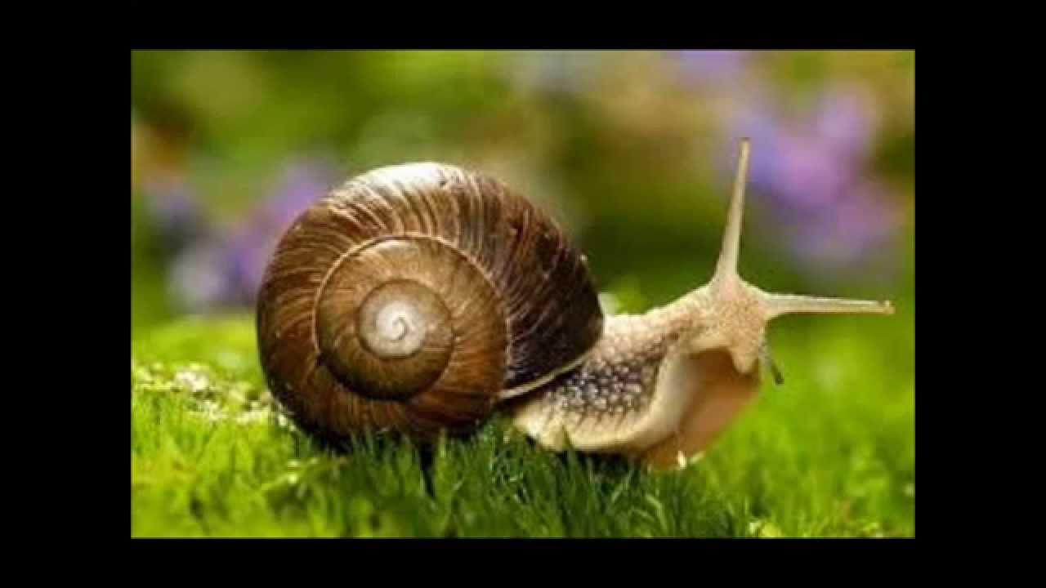
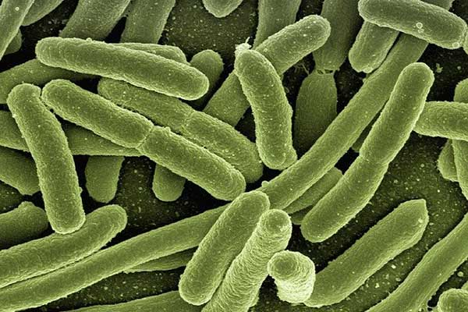
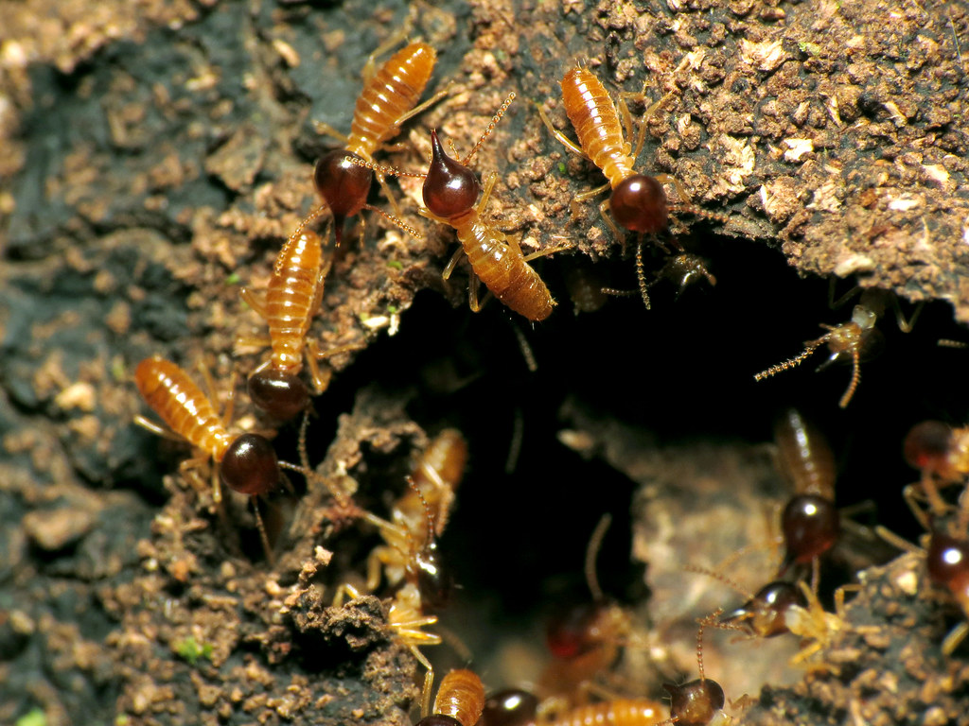
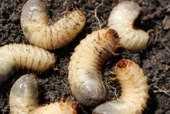
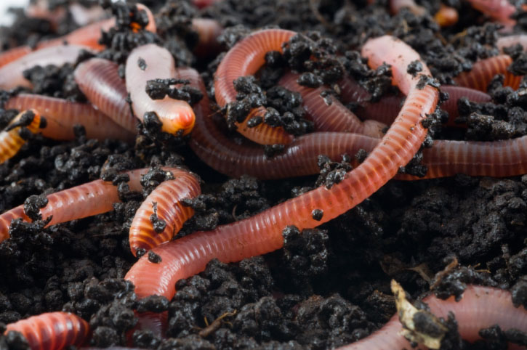
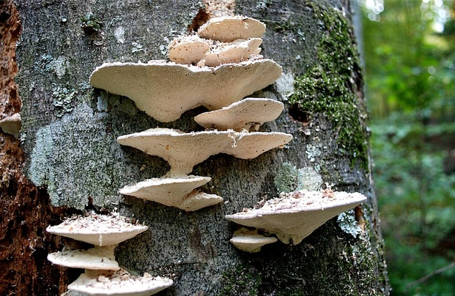
Snails or slugs eat dead plant matter.
Bacteria: decompose any dead or decaying organic matter
Termites eat dead or decaying wood.
What am I?
Maggots eat dead or decaying plants and animals
Earthworms eat dead or decaying plants.
Mushrooms/fungi eat dead or decaying leaves, pine needles, and wood.

Slide 4
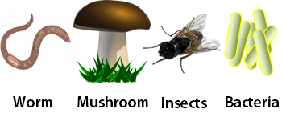
Why are Decomposers important?
They put nutrients back into our soil that our producers will use to grow.
Without them our world would be full of dead and decaying plants and animals

Slide 5
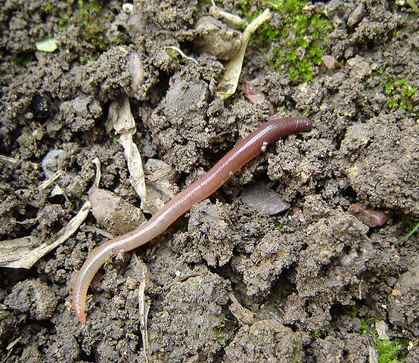
Earthworms
The Super Decomposer!
As they tunnel through soil, eating the decaying matter and pooping out soil-enhancing waste, earthworms help to break up compacted soil. This allows water, air and nutrients to get to the roots more efficiently.
Worm video

Slide 6
It’s Time To Investigate Decomposers!

Slide 7
Investigate
Fill your plastic bin with two inches of soil
Add layers to your bin in the following order:
Dried leaves
½ inch of soil
Mixture of fruit and vegetable scraps
½ inch of soil
Crushed eggshells
½ inch of soil
Using a marker, draw a line at each layer labeling them, “soil”, “dried leaves”, etc.
Looking at the side of the box, draw what you see on your activity sheet, labeling the layers.
Using the spray bottle, add water to the box. Be careful, you don’t want to make your soil muddy. Try not to mix up the layers.
Place 10 earthworms on the top layer of the box.
Wait 10 minutes, then draw your observations. Label your drawing. Describe what you see.
Record your observations on your activity sheet every day for the next 5 days.
Today, you will investigate how decomposers do their work. You will observe differences in systems with and without worms.

Slide 8
Name: ______________________________
Observation activity sheet
Day 1: Draw what you are observing. Give details and be sure to label your drawing.
What do you wonder? _________________________________________________________________________
____________________________________________________________________________________________

Slide 9
Name: ______________________________
Observation activity sheet
Day 2: Draw what you are observing. Give details and be sure to label your drawing.
What do you wonder? _________________________________________________________________________
____________________________________________________________________________________________

Slide 10
Name: ______________________________
Observation activity sheet
Day 3: Draw what you are observing. Give details and be sure to label your drawing.
What do you wonder? _________________________________________________________________________
____________________________________________________________________________________________

Slide 11
Name: ______________________________
Observation activity sheet
Day 4: Draw what you are observing. Give details and be sure to label your drawing.
What do you wonder? _________________________________________________________________________
____________________________________________________________________________________________

Slide 12
Name: ______________________________
Observation activity sheet
Day 5: Draw what you are observing. Give details and be sure to label your drawing.
What was your favorite part about this assignment? ____________________________________________________________________________________________
____________________________________________________________________________________________

Slide 13
I wonder cards

Slide 14
I wonder…
I wonder…
When a decomposer dies, who will decompose that decomposer?
Do you think worms can eat through a banana peel and eat a whole banana since they don’t have teeth?
Worms love to eat bananas! Even though worms do not have any teeth to help them chew their food, worms can eat the food when it’s rotting. They eat their food the same way you eat ice cream. They too use their lips to take small bites.
When decomposers die, other decomposers will go to work and feast upon and recycle the dead matter and nutrients back into the food chain!

Slide 15
I wonder…
I wonder…
Why are there so many worms when it rains?
Why do you suppose worms like damp conditions or wet dirt instead of dry dirt?
When the rain hits the ground, it creates vibrations on the soil surface. This causes earthworms to come out of their burrows to the surface. Earthworms find it easier to travel across the surface of the soil when it is wet, as they need a moist environment to survive.
All earthworms need a moist environment, as they breath through their skin (they have no lungs) and need moisture for respiration.

