Slide 1
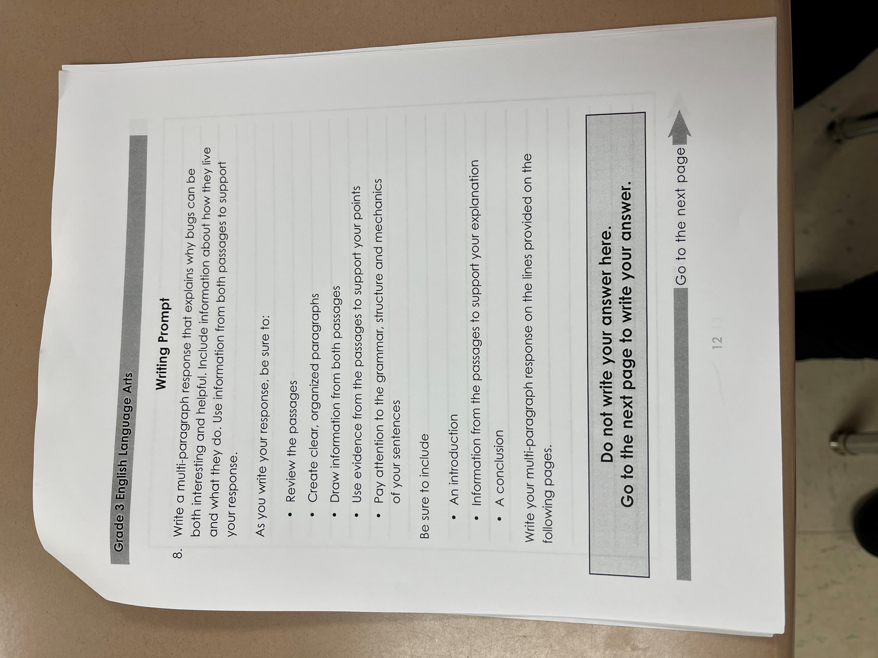
Scoring Camp Links
2 Day Scoring Camp For OST Third Grade
DAY 1
Distribute any released OST passages for third grade. Read writing prompt FIRST, so that students are aware of the question being asked. Discuss for clarification.
Go over the large OST kid-friendly rubric on the board, section by section. We use sticky notes with synonyms to remind us of difficult words on the rubric.

Slide 2
3. Read aloud both passages from the OST,
as students follow along. Model skills
such as think aloud, summarizing, and
rereading for clarification. Have
students highlight any information that
may help them answer the writing prompt.
4. Allow students 50 minutes to respond to the
prompt.

Slide 3
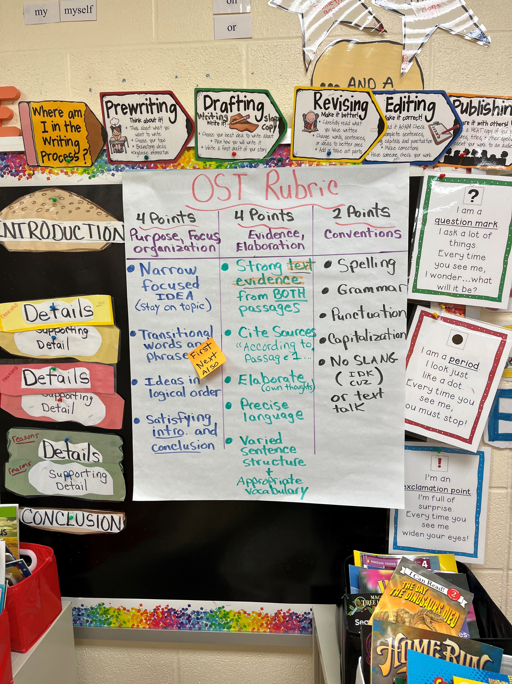
DAY 2
Review both OST passages and writing rubric.
In small groups, students will use the large rubric to figure out
a score for the displayed sample.
When all groups have a score, display the
actual score and rationale received. Discuss
using each section of the rubric. Display as
many examples as you feel is necessary. Some
of my students like to have their own writing
displayed and discussed.
4. Students are then assigned to individual or
group writing conferences.

Slide 4
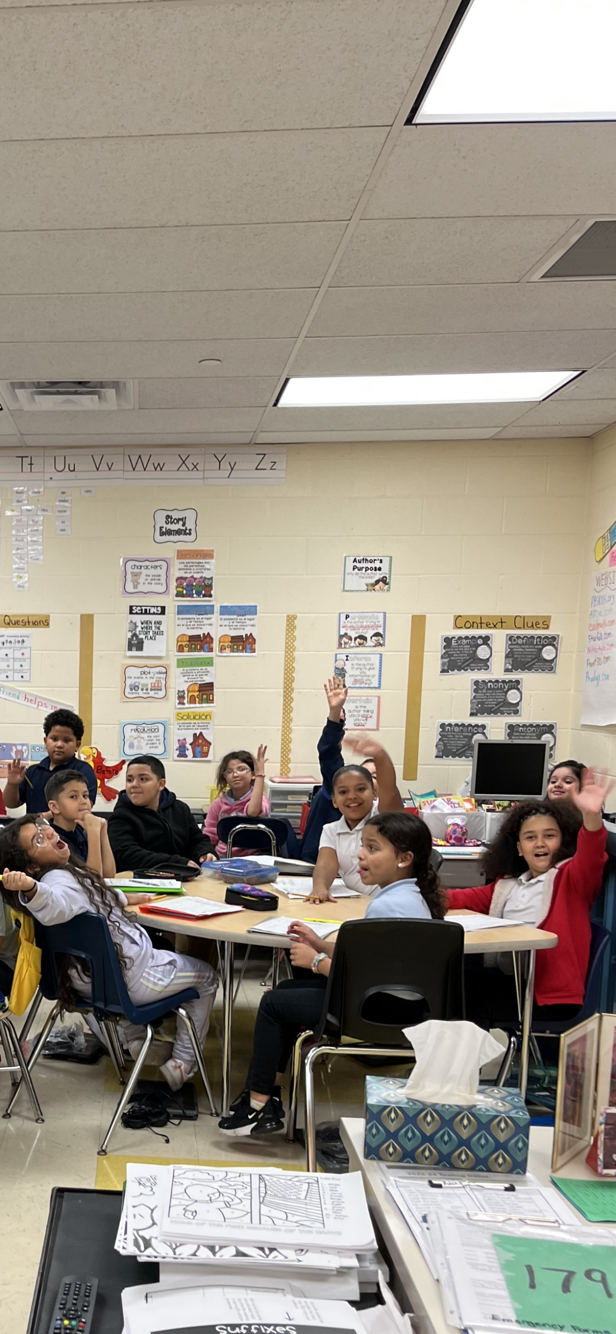
TIPS FOR SUCCESS
This is our students’ first look at the OST, so everything should be presented
in chunks, modeling along the way.
I like to focus on one part of the rubric each time we take an assessment.
Combining OST with a scoring camp allows for our scholars to see examples
of both excellent and poor writing. It also helps them to understand
the very extensive writing rubric.
This process can be modified in many ways to suit the grade level
and the needs of our students. (I like to reward the groups for close
scores)
You can use paper copies or do everything electronically, or, as I do,
a combination of both.
6. HAVE FUN!! OUR STUDENTS NEED TO SEE THAT IF YOU CAN THINK IT,
YOU CAN READ IT, AND WRITE IT!!!!!!!!!!!!!!!

